Slide 1
Java Database Connectivity
JDBC - MYSQL

Slide 2
Java Database Connectivity
JDBC provides an interface which allows you to perform SQL operations independently of the instance of the used database. To use JDBC, you require the database specific implementation of the JDBC driver.
Before we start: https://dev.mysql.com/downloads/connector/

Slide 3
Exercise: create example database
CREATE TABLE `students` (
`id` varchar(7) NOT NULL,
`name` varchar(20) NOT NULL,
`lastname` varchar(20) NOT NULL,
`age` int(11) NOT NULL
)

Slide 4
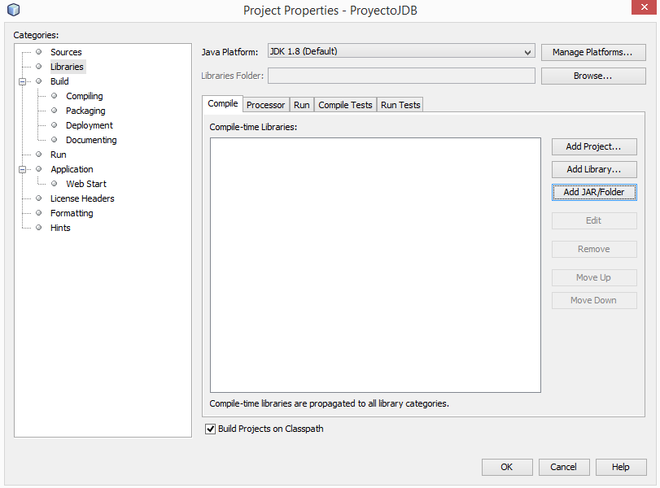
Adding jar to the classpath

Slide 5
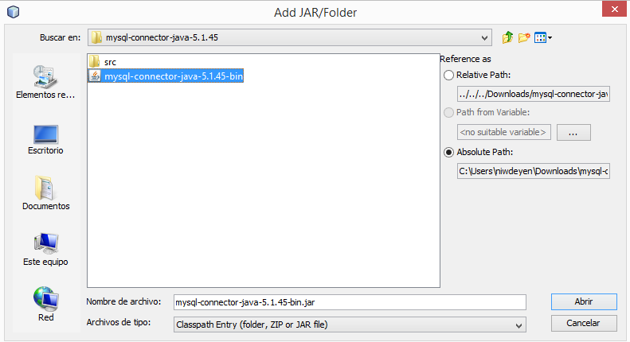
Adding jar to the classpath

Slide 6
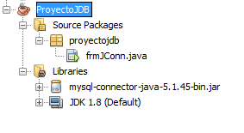
Adding jar to the classpath

Slide 7
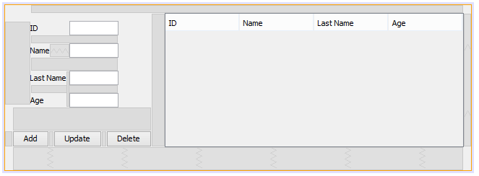
Design

Slide 8
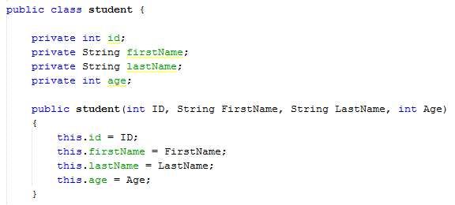
class student

Slide 9
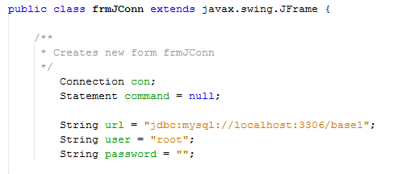
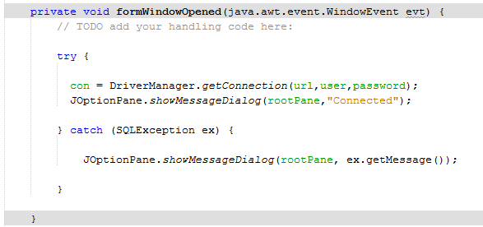
connect to the MySQL database

Slide 10
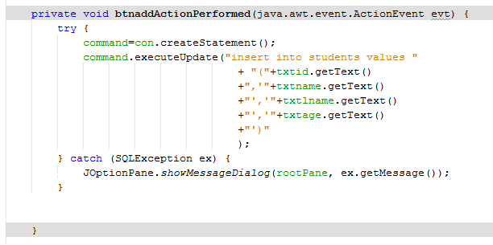
Perform inserts, deletes, and updates: executeUpdate

Slide 11
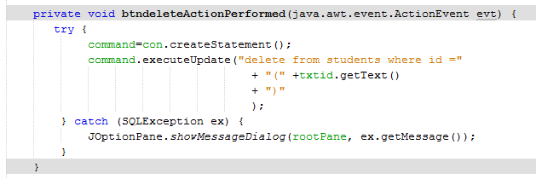
Delete

Slide 12
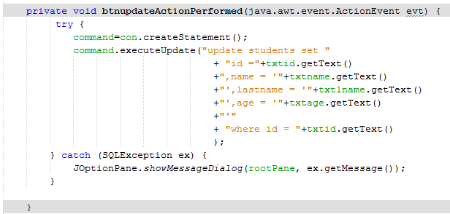
update

Slide 13
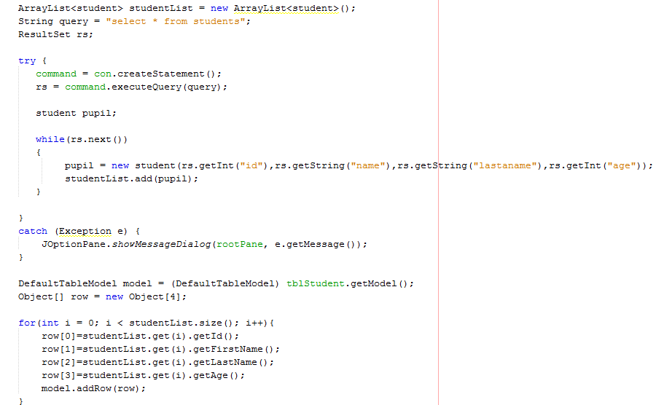
Select:
executeQuery

Slide 14
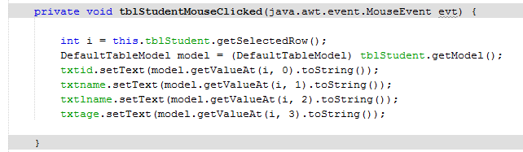
Get data from table

